Slide 1

Build enterprise network (many site ) Project Proposal
Presented to you by :
- Ahmed Elshahat Mahmoud Elshahat (Team leader)
- Noor Alain Adel Mazroa
- Ahmed Mohamed Ragab
-Ebrahim Tala t Ebrahim
Under Supervision of Eng. Mohammed Nasr
Training company : Harvest company

Slide 2
Overview
The Build Enterprise Network (Multi-Site) project is focused on designing and implementing a robust, scalable, and secure network infrastructure for an enterprise with multiple locations. The objective is to connect these 3 sites into a unified network that allows for seamless communication, efficient data transfer, and centralized management.
This project will involve the configuration of routers, switches, and other necessary networking components to ensure secure inter-site connectivity. It also emphasizes redundancy, load balancing, and high availability to minimize downtime and ensure reliable access to critical enterprise applications and services across all locations. By leveraging advanced network design principles and industry best practices, this project aims to create an optimized, cost-effective network solution tailored to the enterprise's specific operational needs.

Slide 3
Enterprise Network Project Objectives
1- Establish secure, scalable connectivity between multiple sites (Mansoura, Cairo, Alexandria).
2- Implement VLAN segmentation for enhanced security and traffic management.
3-Provide seamless inter-VLAN routing and traffic control for improved network performance.
4-Ensure high availability using HSRP and EtherChannel with redundancy across access and distribution layers.
5-Set up secure remote access with SSH and port security to limit unauthorized access.
6-Configure AAA (Authentication, Authorization, and Accounting) for centralized access control and enhanced security.
7-Configure core services like DHCP, NTP, EIGRP, PPP, and ACLs for efficient network operations

Slide 4
Stages of building the network
01
02
03
04
Building the internal network
Configuration for Acess and Distribution Switches
Configuration For Routers
Services configuration and Final Presentation

Slide 5
Week 01

Slide 6
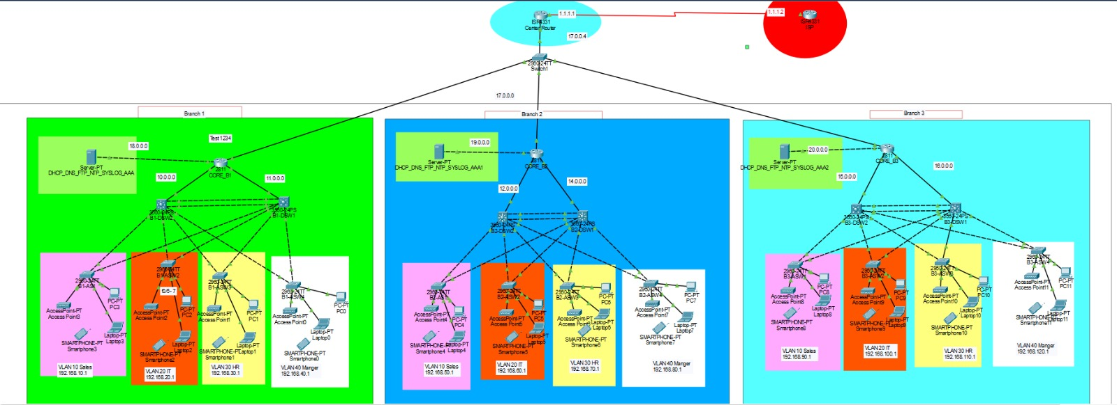
Week one mainly focuses on Installing internal network using cisco Switches & Router.
The design used as shown in the figure, it represents a 3 branches enterprise in 3 different locations (Mansoura, Cairo, and Alexandria) inside the Arab republic of Egypt.
As a team we divided the required tasks to build the following figure as below:
1. Ahmed Elshahat :
- led the network design and installation, configuring the core infrastructure and guiding the team.
2. Noor Alain :
- assisted in setting up the network layout and ensuring scalability.
3. Ahmed Ragab:
- helped configure switches and validate connectivity.
4. Ebrahim Talat:
- supported the setup and testing of network components. We Used Cisco packet tracer to simulate the case.

Slide 7
Week 02

Slide 8
In the second week we did the basic configration for the access and distribution switches and Using the following steps :
01
VLAN Creation
Segmenting Departments and enhancing security,stop domain broadcast
VLAN 10 : SALES
VLAN 20 : IT
VLAN 30 :HR
VLAN 40 : MANAGER
02
Inter Vlan used MLS
Connected different VLANS
Ip routing
Int VLAN 10,20,30,40
Assign IP subnet
host standby router protocol, provides router redundancy, ensuring failover and uninterrupted network connectivity
Enter each VLAN
Standby num_VLAN ip
Example
Int vlan 10
Standby 10 ip 192.168.10.100
03
HSRP
Etherchannel
Redundancy, Load balance
PAgP (Port Aggregation Protocol)
A Cisco
auto -Desirable
04

Slide 9
In the second week we did the basic configration for the access and distribution switches and Using the following steps :
05
STP Prevent loops and stability.used PVSPT forVLAN1,10,20 primary on DSw1 ,Vlan 30 Secondary on DSW2 Port Fast is an STP feature that immediately transitions ports to forwarding state, bypassing listening/learning, for end devices.
.spanning tree vlan 1,10.20 root primary DWS1
spanning tree vlan 30 root secondary DWS2
STP and Portfast
(Secure Shell) is a cryptographic protocol that provides secure remote access and management of devices over an encrypted connection
Set a Hostname
Configure Domain Name
Generate RSA Keys
Configure Local Username and Password
enable SSH on VTY Lines
06
SSH
07
limits the number of MAC addresses on a switch port, enhancing security by preventing unauthorized device access
Port Security

Slide 10
Week 02 tasks were distributed as below:
1- Ahmed Elshahat
configuration of branch 1
VLAN
Inter-VLAN routing.
EtherCHSRPhannel
SSH and config Root bridge
2- Noor Alain
configuration of branch 2
VLAN
Inter-VLAN routing.
HSRP
EtherChannel
SSH and config Root bridge
3- Ebrahim Talat
configuration of branch 3
VLAN
Inter-VLAN routing.
HSRP
EtherChannel
SSH and config Root bridge
4- Ahmed Ragab
configuration of branch 1,2,3
Config access port as port fast at Access SW
Protect Access port from receive unexpected PBDU
Config port security at access SW
Save Config at NVRAM

Slide 11
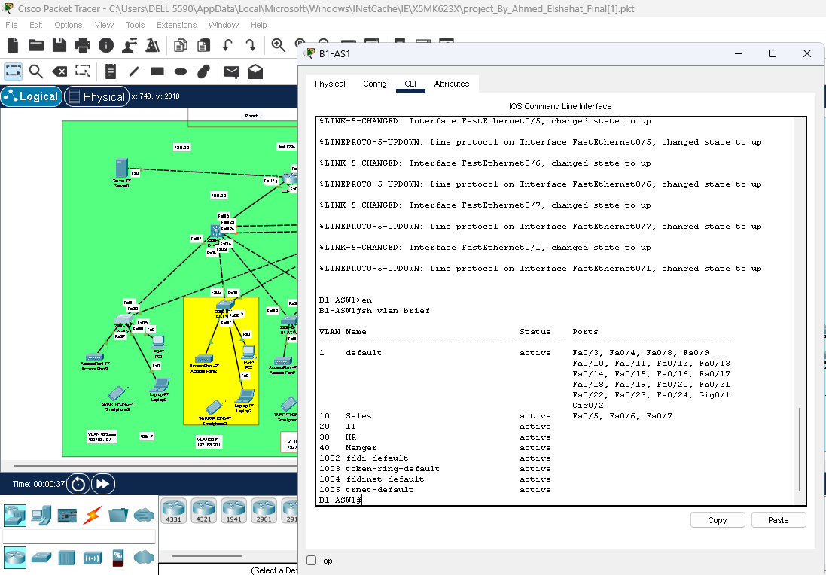
The Used configuration at all access switches:
B1-ASW1(config-vlan)#name Sales
B1-ASW1(config)#vlan 20
B1-ASW1(config-vlan)#name IT
B1-ASW1(config)#vlan 30
B1-ASW1(config-vlan)#name HR
B1-ASW1(config)#vlan 40
B1-ASW1(config-vlan)#name Manger
B1-ASW1(config)#interface range f0/5-7
B1-ASW1(config-if-range)#switchport mode acces
B1-ASW1(config-if-range)#switchport access vlan 10
B1-ASW1(config)#interface range f0/5-7
B1-ASW1(config-if-range)# switchport mode access
B1-ASW1(config-if-range)# switchport port-security
B1-ASW1(config-if-range)#switchport port-security mac-address sticky
B1-ASW1(config-if-range)# switchport port-security violation restrict
B1-ASW1(config-if-range)# spanning-tree portfast
B1-ASW1(config-if-range)# spanning-tree guard root
B1-ASW1(config-if-range)# spanning-tree bpduguard enable
B1-ASW1(config)#interface range f0/1-2
B1-ASW1(config-if-range)#switchport mode trunk

Slide 12
The Used configuration at all Distribution Switches at each branch:
B1-DSW1(config)#ip routing **********
B1-DSW1(config)#vlan 10
B1-DSW1(config-vlan)#name Sales
B1-DSW1(config)#vlan 20
B1-DSW1(config-vlan)#name IT
B1-DSW1(config)#vlan 30
B1-DSW1(config-vlan)#name HR
B1-DSW1(config)#vlan 40
B1-DSW1(config-vlan)#name Manger
B1-DSW1(config)#interface range f0/1-4
B1-DSW1(config)#switchport trunk encasp dot1q
B1-DSW1(config)#switchport mode trunk
B1-DSW1(config)#interface vlan 10
B1-DSW1(config-if)# ip add 192.168.10.1 255.255.255.0
B1-DSW1(config-if)# no sh
B1-DSW1(config)#interface vlan 20
B1-DSW1(config-if)# ip add 192.168.20.1 255.255.255.0
B1-DSW1(config-if)# no sh
B1-DSW1(config)#interface vlan 30
B1-DSW1(config-if)# ip add 192.168.30.1 255.255.255.0
B1-DSW1(config-if)# no sh
B1-DSW1(config)#interface vlan 40
B1-DSW1(config-if)# ip add 192.168.40.1 255.255.255.0
B1-DSW1(config-if)# no sh
B1-DSW1(config)#interface range f0/23-24
B1-DSW1(config-if)# channel-protocol pagp
B1-DSW1(config-if)# channel-group 1 mode Desirable
B1-DSW1(config-if)#switchport trunk encasp dot1q
B1-DSW1(configif)#switchport mode trunk
B1-DSW1(config)#interface vlan 10
B1-DSW1(config-if)#standby 10 ip 192.168.10.100
B1-DSW1(config)#interface vlan 20
B1-DSW1(config-if)#standby 20 ip 192.168.20.100
B1-DSW1(config)#interface vlan 30
B1-DSW1(config-if)#standby 30 ip 192.168.30.100
B1-DSW1(config)#interface vlan 40
B1-DSW1(config-if)#standby 40 ip 192.168.40.100
B1-DSW1(config)#ip domain-name branch1
B1-DSW1(config)#crypto key gen rsa
B1-DSW1(config)#line vty 0 4
B1-DSW1(config-line)#transport input ssh
B1-DSW1(config-line)#login local
B1-DSW1(config-line)#exit
B1-DSW1(config)username Admin privellage 15 password 1234
B1-DSW1(config)enable secret 1234
B1-DSW1(config)int g0/1
B1-DSW1(config-if)no switchport
B1-DSW1(config-if)ip add 11.0.0.2 255.0.0.0
B1-DSW1(config-if)no sh
B1-DSW1(config)#router eigrp1
B1-DSW1(config-router)# network 192.168.10.0 0.0.0.255
B1-DSW1(config-router)# network 192.168.20.0 0.0.0.255
B1-DSW1(config-router)# network 192.168.30.0 0.0.0.255
B1-DSW1(config-router)# network 192.168.40.0 0.0.0.255
B1-DSW1(config-router)# network 11.0.0.0 0.255.255.255

Slide 13
Week 03

Slide 14
In the Third week we applied the basic configurations and some important protocols to configure core routers in the network to link the 3 sites together
DHCP : Dynamic Host Configuration Protocol
EIGRP: Enhanced Interior Gateway Routing Protocol
1.Automatic IP assignment
2. Reducing admin Overhead
3. Efficient IP Usage
1.Fast Convergence
2.Reducing Bandwidth Usage
3.Load Balance
1.Simplified Routing
2.Efficient Traffic Management
3.Facilitates Internet Access
Basic configuration and subinterface
Default Route:

Slide 15
Week 03 tasks were distributed as follow:
Ahmed Elshahat ,Noor Alain Adel, Ahmed Ragab, and Ebrahim Talat
contributed equally, configuring routers, setting up Eigrp , DHCP,Default route and ensuring routes were correctly advertised.

Slide 16
The Used configuration at all core router at each branch:
B1-core_R(config)#int f0/0
B1-core_R(config-if)#ip add 10.0.0.1 255.0.0.0
B1-core_R(config-if)#no sh
B1-core_R(config)#int f0/1
B1-core_R(config-if)#ip add 11.0.0.1 255.0.0.0
B1-core_R(config-if)#no sh
B1-core_R(config)#int f1/0
B1-core_R(config-if)#ip add 17.0.0.1 255.0.0.0
B1-core_R(config-if)#no sh
B1-core_R(config)#int f1/1
B1-core_R(config-if)#ip add 18.0.0.1 255.0.0.0
B1-core_R(config-if)#no sh
B1-core_R(config)#router eigrp 1
B1-core_R(config-router)#network 10.0.0.0 0.255.255.255
B1-core_R(config-router)#network 11.0.0.0 0.255.255.255
B1-core_R(config-router)#network 17.0.0.0 0.255.255.255
B1-core_R(config-router)#network 18.0.0.0 0.255.255.255 a
B1-DSW1,DSW2(config)#int vlan 10
B1-DSw1,DSW2(config-if)#ip helper-address 18.0.0.10
B1-DSW1,DSW2(config)#int vlan 20
B1-DSw1,DSW2(config-if)#ip helper-address 18.0.0.10
B1-DSW1,DSW2(config)#int vlan 30
B1-DSw1,DSW2(config-if)#ip helper-address 18.0.0.10
B1-DSW1,DSW2(config)#int vlan 40
B1-DSw1,DSW2(config-if)#ip helper-address 18.0.0.10

Slide 17
Week 04

Slide 18
At week 04Configuration for Services such as NTP, Log server, PPP, and ACLs To monitor your traffic
NTP network time protocol
PPP Point to point Protocol
03
1.Time synchronization
2.Accurate Logging and Auditing
3.Improved Security
01
1.Data Link Layer Communication
2.Support Authentication
3.Error Detection
4-between ISP and center router for improve Bandwitdh
ACL Access Control List
Log Server
02
04
1.Centralized Logging
2.Enhanced Security Monitoring
3.Improved Troubleshooting
1.Traffic Filtering
2.Enhanced Security
3.Monitoring and Logging

Slide 19
At week 04Configuration for Services such as NTP, Log server, PPP, and ACLs To monitor your traffic
01
02
Log Server
NTP network time protocol
B1-core-R(config)# ntp server 20.0.0.10
ntp authenticate
ntp trusted-key 1
ntp authentication-key 1 md5 cisco
ntp update-calendar
B1-core-R#show clock detail
B1-core-R(config)#logging host 20.0.0.10
service timestamps log datetime mse
login on-success log
login on-failure log

Slide 20
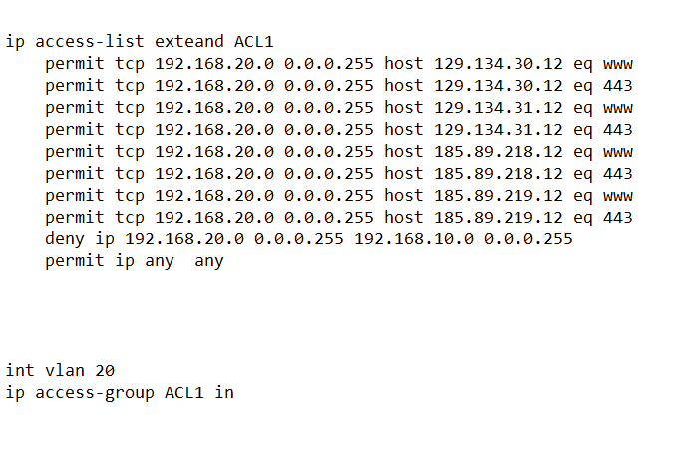
At week 04Configuration for Services such as NTP, Log server, PPP, and ACLs To monitor your traffic
03
PPP Point to point Protocol
04
ACL Access Control List
Between center router and isp
B1-core-R (config)#username isp password 123
B1-core-R (config)#int s0/1/0
encapsaultion ppp
ppp authencation chap
ISP1 (config)#username center_router password 123
isp1(config)#int s0/1/0
encapsaultion ppp
ppp authencation chap
B1-DSW1,2

Slide 21
Week 04 tasks were distributed as follow:
NTP Configuration
ACL Configuration & AAA
PPP Configuration
Syslog Configuration
All routers were synchronized with the NTP server at the Cairo router, ensuring accurate timekeeping across the network
Ahmed Mohamed
Configured Access Control Lists (ACLs) to permit IT department traffic to Facebook while restricting access for the Sales department, adding a layer of security and traffic control.
Ahmed Elshahat
A PPP connection was established between the Cairo router and the ISP, ensuring reliable and secure communication.
Noor Alain
Configured all routers to send log messages to the log server, enabling effective traffic monitoring and troubleshooting through centralized logging
Ebrahim Talat

Slide 22
The final Result

Slide 23
Thank you for your time ☺

